Slide 1
LINUX UTILITIES
AND
SHELL PROGRAMMING

Slide 2
Introduction to Linux:
Linux is a Unix-like computer operating system assembled under the model of free and open source software development and distribution.
The defining component of Linux is the Linux kernel, an operating system kernel first released 5 October 1991 by Linus Torvalds.
Linux was originally developed as a free operating system for Intel x86-based personal computers.
It has since been ported to more computer hardware platforms than any other operating system.

Slide 3
Basic Features
Following are some of the important features of Linux Operating System.
• Portable - Portability means softwares can works on different types of hardwares in same way. Linux kernel and application programs supports their installation on any kind of hardware platform.
• Open Source - Linux source code is freely available and it is community based development project. Multiple teams works in collaboration to enhance the capability of Linux operating system and it is continuously evolving.
• Multi-User - Linux is a multiuser system means multiple users can access system resources like memory/ ram/ application programs at same time.
• Security - Linux provides user security using authentication features like password protection/ controlled access to specific files/ encryption of data.

Slide 4
• Multiprogramming - Linux is a multiprogramming system means multiple applications can run at same time.
• Hierarchical File System - Linux provides a standard file structure in which system files/ user files are arranged.
• Shell - Linux provides a special interpreter program which can be used to execute commands of the operating system. It can be used to do various types of operations, call application programs etc.

Slide 5
Linux Advantages
1.Low cost:
You don’t need to spend time and money to obtain licenses since Linux and much of its software come with the GNU General Public License.
You can start to work immediately without worrying that your software may stop working anytime because the free trial version expires.
Additionally, there are large repositories from which you canfreely download high quality software for almost any task you can think of.
2.Stability:
Linux doesn’t need to be rebooted periodically to maintain performance levels.
it doesn’t freeze up or slow down over time due to memory leaks and such.
Continuous up times of hundreds of days (up to a year or more) are not uncommon.

Slide 6
3.Performance:
Linux provides persistent high performance on workstations and on networks.
It can handle unusually large numbers of users simultaneously, and can make old computers sufficiently responsive to be useful again.
4.Network friendliness:
Linux was developed by a group of programmers over the Internet and has therefore strong support for network functionality; client and server systems can be easily set up on any computer running Linux.
It can perform tasks such as network backups faster and more reliably than alternative systems.

Slide 7
5.Flexibility:
Linux can be used for high performance server applications, desktop applications, and embedded systems.
You can save disk space by only installing the components needed for a particular use.
You can restrict the use of specific computers by installing for example only selected office applications instead of the whole suite.
6.Compatibility:
It runs all common Unix software packages and can process all common file formats.

Slide 8
7.Choice:
The large number of Linux distributions gives you a choice.
Each distribution is developed and supported by a different organization.
You can pick the one you like best; the core functionalities are the same; most software runs on most distributions.
8.Fast and easy installation:
Most Linux distributions come with user-friendly installation and setup programs.
Popular Linux distributions come with tools that make installation of additional software very user friendly as well.
9.Full use of hard disk:
Linux continues work well even when the hard disk is almost full.
.

Slide 9
10.Multitasking:
Linux is designed to do many things at the same time; e.g., a large printing job in the background won’t slow down your other work.
11.Security:
Linux is one of the most secure operating systems. “Walls” and flexible file access permission systems prevent access by unwanted visitors or viruses.
Linux users have to option to select and safely download software, free of charge, from online repositories containing thousands of high quality packages.
12.Open Source:
If you develop software that requires knowledge or modification of the operating system code, Linux’s source code is at your fingertips.
Most Linux applications are Open Source as well

Slide 10
Linux Distribution (Operating System) Names
A few popular names:
1.Redhat Enterprise Linux
2.Fedora Linux
3.Debian Linux
4.Suse Enterprise Linux
5.Ubuntu Linux
Common Things Between Linux & UNIX
Both share many common applications such as:
1.GUI, file, and windows managers (KDE, Gnome)
2.Shells (ksh, csh, bash)
3.Various office applications such as OpenOffice.org

Slide 11
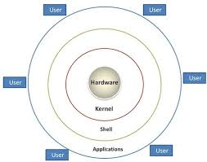
Layered Architecture:

Slide 12
Linux System Architecture is consists of following layers
• Hardware layer - Hardware consists of all peripheral devices (RAM/ HDD/ CPU etc).
• Kernel - Core component of Operating System, interacts directly with hardware, provides low level services to upper layer components.
• Shell - An interface to kernel, hiding complexity of kernel's functions from users. Takes commands from user and executes kernel's functions.
• Utilities - Utility programs giving user most of the functionalities of an operating systems.

Slide 13
LINUX File system
Linux file structure files are grouped according to purpose. Ex: commands, data files, documentation.
Parts of Unix directory tree are listed below. All directories are grouped under the root entry "/".
1. / – Root
▪ Every single file and directory starts from the root directory.
▪ Only root user has write privilege under this directory.
▪ Please note that /root is root user’s home directory, which is not same as /.
2. /bin – User Binaries
▪ Contains binary executables.
▪ Common linux commands you need to use in single-user modes are located under this
directory. Commands used by all the users of the system are located here. For example: ps, ls, ping, grep, cp.

Slide 14
3. /sbin – System Binaries
▪ Just like /bin, /sbin also contains binary executables.
▪ But, the linux commands located under this directory are used typically by system aministrator, for system maintenance purpose.
▪ For example: iptables, reboot, fdisk, ifconfig, swapon
4. /etc – Configuration Files
▪ Contains configuration files required by all programs.
▪ This also contains startup and shutdown shell scripts used to start/stop individual programs.
▪ For example: /etc/resolv.conf, /etc/logrotate.conf

Slide 15
6. /proc – Process Information
▪ Contains information about system process.
▪ This is a pseudo filesystem contains information about running process. For example: /proc/{pid} directory contains information about the process with that particular pid.
▪ This is a virtual filesystem with text information about system resources. For example: /proc/uptime
7. /var – Variable Files
▪ var stands for variable files.
▪ Content of the files that are expected to grow can be found under this directory.
▪ This includes — system log files (/var/log); packages and database files (/var/lib); emails (/var/mail); print queues (/var/spool); lock files (/var/lock); temp files needed across reboots (/var/tmp);

Slide 16
8. /tmp – Temporary Files
▪ Directory that contains temporary files created by system and users.
▪ Files under this directory are deleted when system is rebooted.
9. /usr – User Programs
▪ Contains binaries, libraries, documentation, and source-code for second level programs.
▪ /usr/bin contains binary files for user programs. If you can’t find a user binary under /bin, look under /usr/bin. For example: at, awk, cc, less, scp
▪ /usr/sbin contains binary files for system administrators. If you can’t find a system binary under /sbin, look under /usr/sbin. For example: atd, cron, sshd, useradd, userdel
▪ /usr/lib contains libraries for /usr/bin and /usr/sbin
▪ /usr/local contains users programs that you install from source. For example, when you install apache from source, it goes under /usr/local/apache2

Slide 17
10. /home – Home Directories
▪ Home directories for all users to store their personal files.
▪ For example: /home/john, /home/nikita
11. /boot – Boot Loader Files
▪ Contains boot loader related files.
▪ Kernel initrd, vmlinux, grub files are located under /boot
▪ For example: initrd.img-2.6.32-24-generic, vmlinuz-2.6.32-24-generic
12. /lib – System Libraries
▪ Contains library files that supports the binaries located under /bin and /sbin
▪ Library filenames are either ld* or lib*.so.*
▪ For example: ld-2.11.1.so, libncurses.so.5.7

Slide 18
13. /opt – Optional add-on Applications
▪ opt stands for optional.
▪ Contains add-on applications from individual vendors.
▪ add-on applications should be installed under either /opt/ or /opt/ sub-directory.
14. /mnt – Mount Directory
▪ Temporary mount directory where sysadmins can mount filesystems.

Slide 19
15. /media – Removable Media Devices
▪ Temporary mount directory for removable devices.
▪ For examples, /media/cdrom for CD-ROM; /media/floppy for floppy drives;
/media/cdrecorder for CD writer
16. /srv – Service Data
▪ srv stands for service.
▪ Contains server specific services related data.
▪ For example, /srv/cvs contains CVS related data.

Slide 20
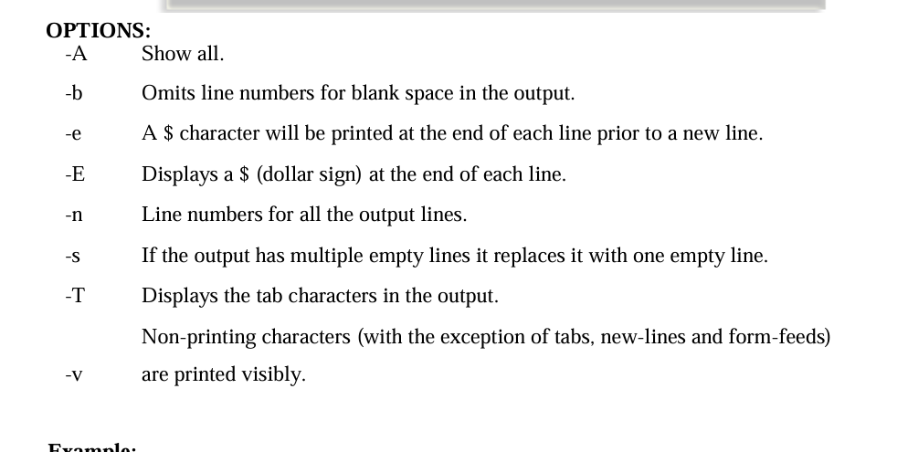
1. Linux Utilities:
1.1 File Handling
utilities: Cat
Command:
cat linux command concatenates files and print it on the standard output.
SYNTAX:
The Syntax is
cat [OPTIONS] [FILE]... OPTIONS: -A -b -e -E -n -s -T -v

Slide 21
To Create a new file:
cat > file1.txt
This command creates a new file file1.txt. After typing into the file press control+d (^d) simultaneously to end the file.
1. To Append data into the file: cat >> file1.txt
To append data into the same file use append operator >> to write into the file, else the file will be overwritten (i.e., all of its contents will be erased).
2. To display a file: cat file1.txt
This command displays the data in the file.
3. To concatenate several files and display: cat file1.txt file2.txt

Slide 22
4. To concatenate several files and to transfer the output to another file. cat file1.txt file2.txt > file3.txt
In the above example the output is redirected to new file file3.txt.
The cat command will create new file file3.txt and store the concatenated output into file3.txt.

Slide 23
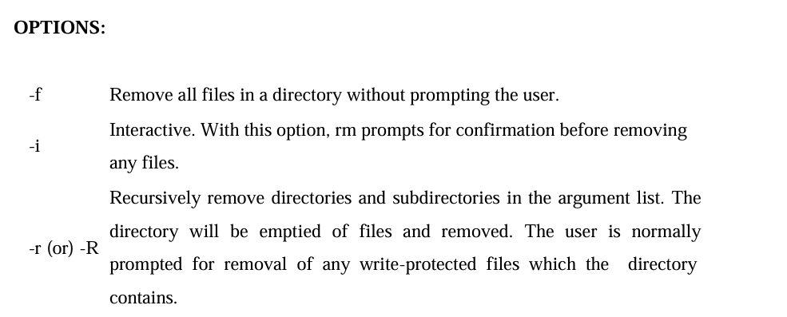
rm COMMAND:
rm linux command is used to remove/delete the file from the directory.
SYNTAX:
The Syntax is
rm [options..] [file | directory]

Slide 24
cd COMMAND:
cd command is used to change the directory.
SYNTAX:
The Syntax is
cd [directory | ~ | ./ | ../ | - ]
OPTIONS:
-L Use the physical directory structure.
-P Forces symbolic links.
EXAMPLE:
1. cd linux-command
This command will take you to the sub-directory(linux-command) from its parent
directory.
2. cd ..
This will change to the parent-directory from the current working directory/sub-directory.
3. cd ~
This command will move to the user's home directory which is "/home/username".

Slide 25
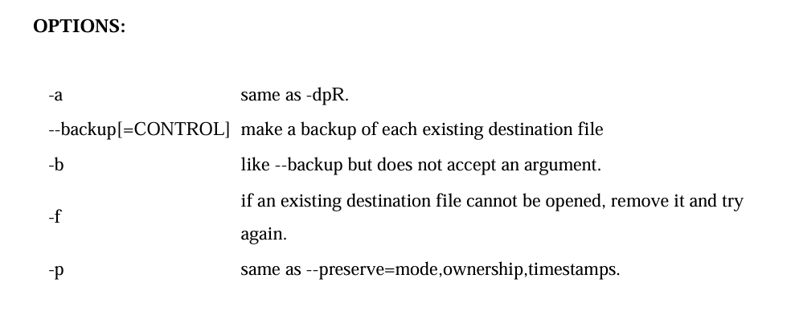
cp COMMAND:
cp command copy files from one location to another. If the destination is an existing file, then
the file is overwritten; if the destination is an existing directory, the file is copied into the
directory (the directory is not overwritten).
SYNTAX:
The Syntax is
cp [OPTIONS]... SOURCE DEST
cp [OPTIONS]... SOURCE... DIRECTORY
cp [OPTIONS]... --target-directory=DIRECTORY SOURCE...

Slide 26
EXAMPLE:
Copy two files: cp file1 file2
The above cp command copies the content of file1.php to file2.php.
1. To backup the copied
file: cp -b file1.php file2.php
Backup of file1.php will be created with '~' symbol as file2.php~.
2. Copy folder and
subfolders: cp -R scripts
scripts1
The above cp command copy the folder and subfolders from scripts to scripts1.

Slide 27
OPTION
L -Lists all the files, directories and their mode, Number of links, owner of the
file, file size, Modified date and time and filename.
-t Lists in order of last modification time.
-a Lists all entries including hidden files.
-d Lists directory files instead of contents.
-p Puts slash at the end of each directories.
-u List in order of last access time.
-i Display inode information.
-ltr List files order by date.
-lSr List files order by file size.
ls COMMAND:
ls command lists the files and directories under current working directory.
SYNTAX:
ls [OPTIONS]... [FILE]

Slide 28
EXAMPLE:
Display root directory contents:
ls /
lists the contents of root directory.
Display hidden files and directories:
ls -a
lists all entries including hidden files and directories.

Slide 29
ln COMMAND:
ln command is used to create link to a file (or) directory. It helps to provide soft link for desired files. Inode will be different for source and destination.
SYNTAX:
The Syntax is
ln [options] existingfile(or directory)name newfile(or directory)name

Slide 30
OPTIONS:
-f Link files without questioning the user, even if the mode of target forbids writing. This is the default if the standard input is not a terminal.
-n Does not overwrite existing files.
-s Used to create soft links.

Slide 31
EXAMPLE:
1. ln -s file1.txt file2.txt
Creates a symbolic link to 'file1.txt' with the name of 'file2.txt'. Here inode for 'file1.txt' and 'file2.txt' will be different.
2. ln -s nimi nimi1
Creates a symbolic link to 'nimi' with the name of 'nimi1'

